Slide 1



JSS Mahavidyapeetha
JSS Academy of Technical Education, Bengaluru
Master of Computer Applications Department
Project Title
“A Parallel Hybrid Model For 5G Network Congestion Control Based On Using Machine Learning Approach”
Presented by:
Name: Ankith N USN: 1JS23MC004 IV Semester
Under the supervision of:
Dr.ROHITAKSHA K
Professor and Head Dept. of MCA
JSS Academy of Technical Education

Slide 2
OUTLINE
1. Abstract / Executive Summary
2. Introduction & Context
3. Problem Statement
4. Objectives
5. Literature Review & Theoretical Framework
6. Methodology / Approach
7. Tools and Techonology
8. Results and Analysis
9. Conclusion
10. Future Scope
11. References
12. Q&A / Thank You

Slide 3
ABSTRACT
The rapid growth of 5G networks has resulted in unprecedented data traffic, increasing the likelihood of network congestion. Traditional congestion control mechanisms often fail to handle the dynamic and high-speed nature of 5G environments.There are several congestion control models that have been proposed to control and predict the possible congestion in 5G technology finding the optimal congestion control model is an important yet challenging task. the supervised and unsupervised machine learning approaches to the task of predicting the possible congestion in the 5G environment. It improves the overall Quality of Service (QoS), reduces latency, and optimizes bandwidth utilization, making it an efficient and scalable solution for the demanding requirements of 5G networks.

Slide 4

INTRODUCTION
With the advent of 5G technology, communication networks have witnessed significant improvements in speed, bandwidth, and connectivity
Traditional congestion control methods, which rely on reactive measures, are inadequate for managing the fast-paced and complex nature of 5G networks.
This project presents a predictive congestion control model that combines Supervised and Unsupervised machine learning Approach
1. Supervised Learning: Provides accurate predictions using historical data for congestion patterns.
2. Unsupervised Learning: Enhances adaptability by detecting new or unexpected traffic patterns in real time
3. Hybrid Model: Achieved by running supervised algorithms in parallel with unsupervised clustering methods allowing both prediction and pattern discovery at the same time.This parallel hybrid approach combines accuracy from supervised learning with adaptability from unsupervised learning, creating a more robust and scalable congestion control system for 5G networks.

Slide 5
PROBLEM STATEMENT
5G networks are congested due to high traffic from numerous connected devices. To solve this Problem we develop an intelligent model capable of predicting and managing congestion. A single machine learning approach is insufficient for handling the large dataset of 5G samples, which are composed using both supervised and unsupervised methods. Therefore, we construct an hybrid model that combines ensemble and clustering algorithms on a parallel framework to effectively address congestion issues

Slide 6
OBJECTIVES:
Parameter Identification: Identify the most important features influencing 5G Congestion like Energy, load, transmit power, and base Station ID.
Supervised Learning Implementation: Implement models Such has Linear Regression, Decision Tree, SVM, and Random Forest also know as Ensemble for Energy consumption prediction.
Unsupervised Learning Implementation: Implement Clustering methods such as KMeans , HDBSCAN Clustering, DBSCAN Clustering, Hierarchical Clustering for traffic pattern detection.
Hybrid Parallel Approach: Implement both Supervised and Unsupervised model in a parallel Architecture to enhance analysis and prediction.
Visualization and Deployment: Create an interactive Dashboard with Python and Steamlit for prediction and result Visualization

Slide 7

DATASET STATISTICS
Source - Kaggle
92629 total samples taken both under supervised and unsupervised
Number of variables | 9
Number of observation | 92629
Missing cells | 0
Missing cells (%) | 0.0%
Duplicate rows | 0
Duplicate rows (%) | 0.0%
Total size in memory | 5.3 MiB
Average record size in memory | 60.0 B

Slide 8
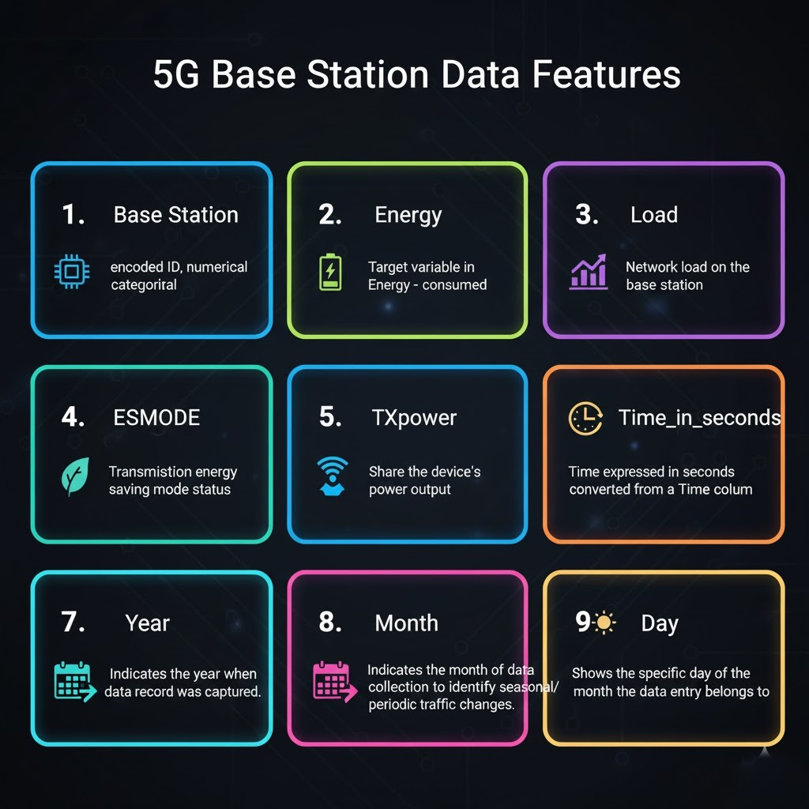
PARAMETERS:
Base Station : encoded ID, numerical categorical
Energy: Target variable in Energy - consumed
Load: Network load on the base station
ESMODE:Transmission energy saving mode status
TXpower: Share the device's power output.
Time_in_seconds:Time expressed in seconds converted from a Time column
Year: Indicates the year when the data record was captured.
Month: Indicates the month of data collection to identify seasonal/periodic traffic changes.
Day: Shows the specific day of the month the data entry belongs to.
Fig. 1 - Parameters

Slide 9
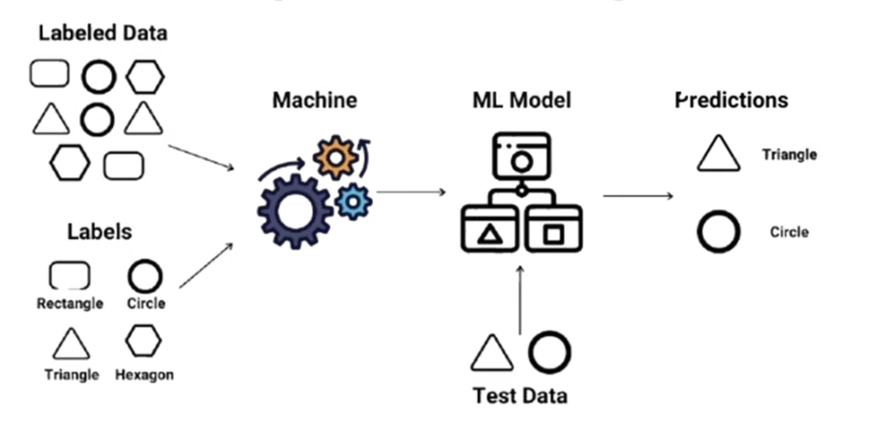
SUPERVISED LEARNING:
Supervised learning is a type of machine learning where the model is trained using labeled data. In this approach, both the input (features) and the corresponding output (labels) are known, allowing the algorithm to learn the mapping between them.
Produces highly accurate predictions for labeled data.
Fig. 2 – Supervised Learning
Linear Regression: A foundational algorithm for understanding linear relationships.
Decision Tree: A powerful model capable of capturing complex, non-linear dependencies.
Random Forest: An ensemble method that combines multiple decision trees for enhanced accuracy and robustness.
Support Vector Machine (SVM): Effective for classification and regression tasks by finding optimal hyperplanes.

Slide 10
ALGORITHMS:
Linear Regression
As a foundational element in our supervised learning exploration, Linear Regression served as a crucial baseline model for predicting 5G network congestion and energy consumption. This algorithm operates on the principle of establishing a linear relationship between input features and the target variable.
In simple terms, Linear Regression attempts to draw a "straight line" that best fits the data points. This line is then used to forecast new congestion values based on incoming network data. While straightforward and easy to interpret, its reliance on linear assumptions means it might not fully capture the intricate, non-linear dynamics inherent in complex 5G environments.
1
2
3
Principle
Mechanism
Performance
Predicts congestion based on linear relationships between network parameters and target variables, acting as a direct forecasting tool.
Functions by fitting a straight line or hyperplane to the data, serving as a simple yet effective baseline for predictive analysis.
Achieved a moderate accuracy with an R² value of approximately 0.55, indicating its foundational but limited predictive power.

Slide 11
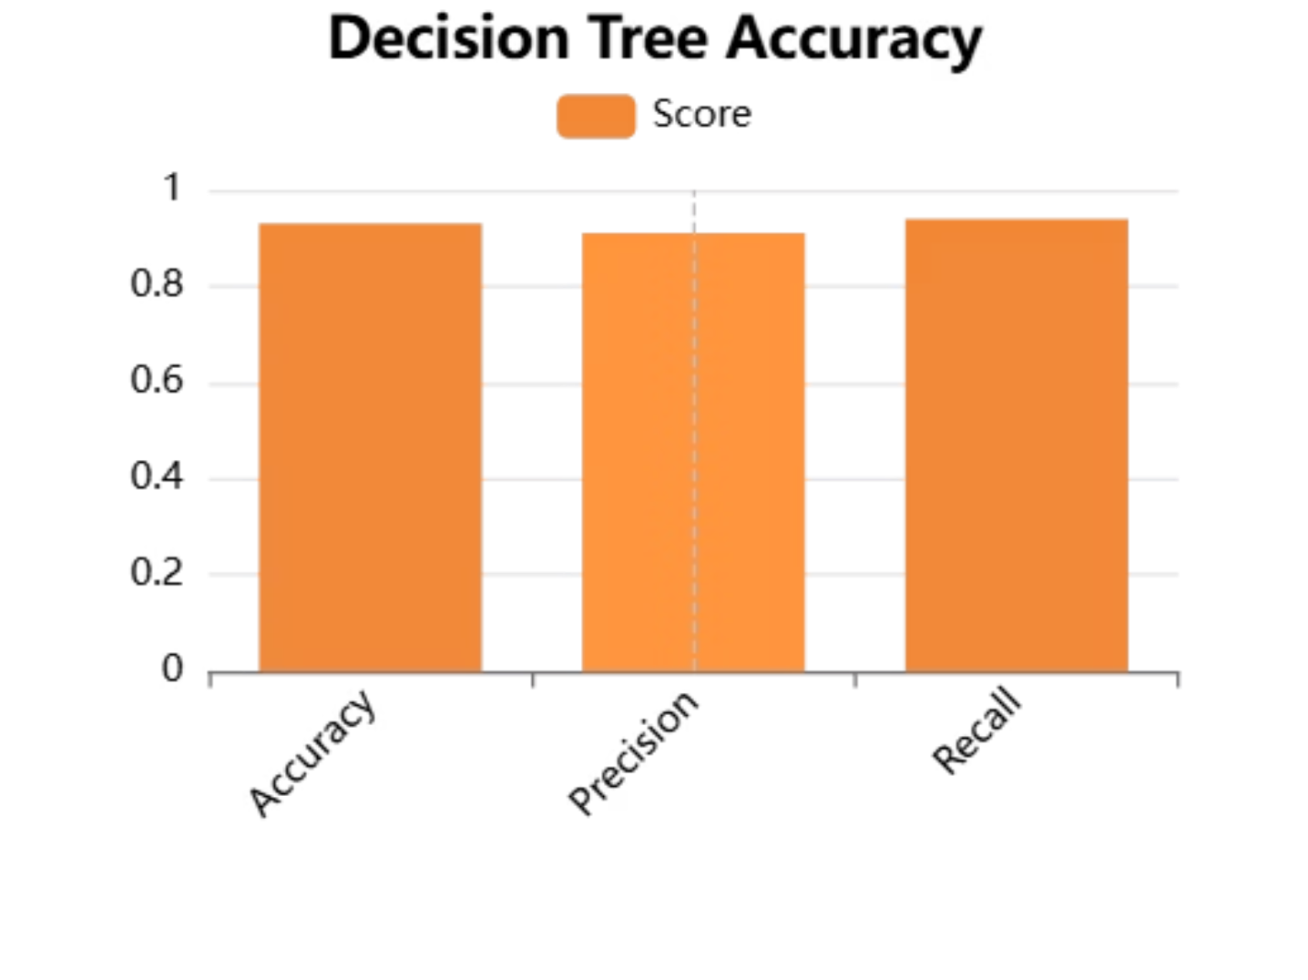
2. Decision Tree:
Building upon the baseline, the Decision Tree algorithm was employed to enhance our congestion prediction capabilities. Unlike Linear Regression, Decision Trees are highly effective at capturing non-linear patterns within the complex 5G network data. They achieve this by partitioning the data based on a series of "if-else" splitting rules, creating a tree-like structure that makes predictions.
A Decision Tree splits the data into branches based on conditions like:
“If latency > 30 ms → high congestion”
“If users < 40 → low congestion”
It forms a tree-like structure of decisions.
Decision Trees performed better than Linear Regression because 5G data contains complex, multi-level patterns.
In our evaluation, the Decision Tree model demonstrated significantly improved accuracy compared to Linear Regression, achieving an impressive R² value of approximately 0.93. This high score underscored its capability to model the complex relationships present in 5G network dynamics effectively.
Fig. 3 – Decision Tree Accuracy

Slide 12
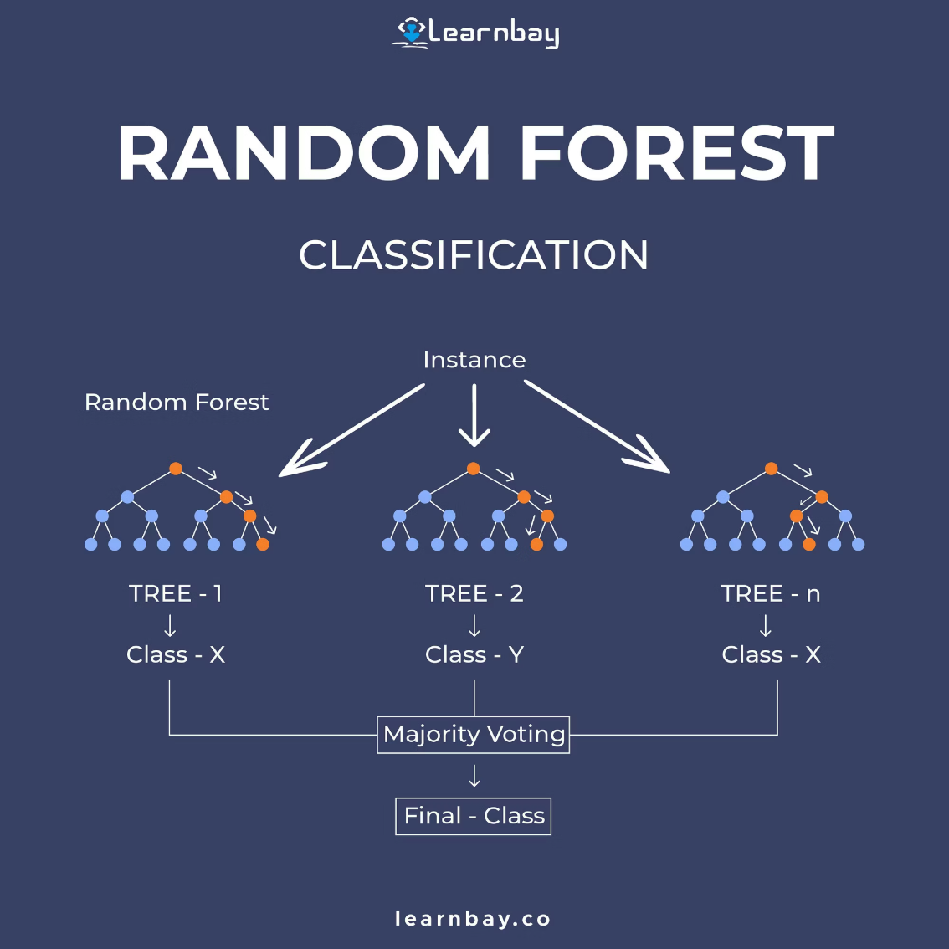


3. Random Forest:
Among the supervised learning algorithms evaluated, Random Forest emerged as the most robust and accurate model for predicting 5G network congestion and energy consumption. This superior performance is attributed to its ensemble learning approach.
The Random Forest model demonstrated exceptional performance in our project, achieving the best supervised R² score of 0.96. This indicates that 96% of the variance in congestion levels could be explained by the model, making it an invaluable tool for proactive congestion control in 5G networks.
Fig. 4 – Random Forest Classification
Ensemble Power
Complex Data Handling
Stability & Accuracy
Combines predictions from multiple decision trees, reducing overfitting and enhancing generalisation.
Excels at navigating the high dimensionality and intricate patterns typical of 5G network data.
Provides more stable and reliable predictions than single models, crucial for critical network operations.

Slide 13
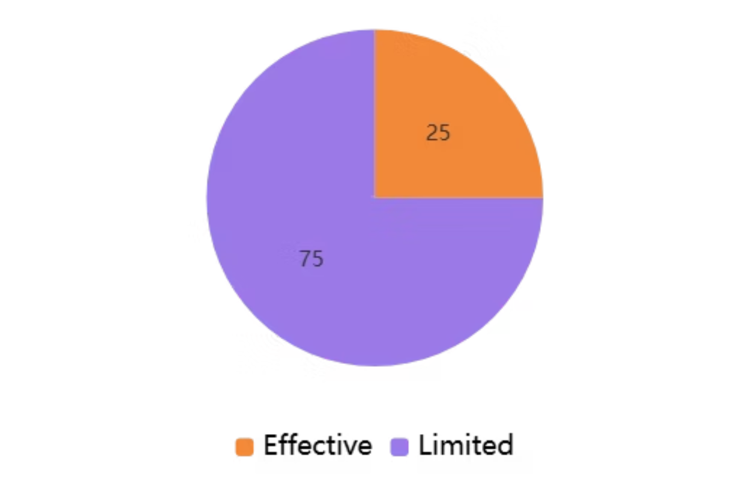
4. Support Vector Machine (SVM):
SVM finds optimal boundaries between different congestion levels but struggles with noisy 5G datasets, resulting in poor performance for this application
Limited effectiveness due to sensitivity to noise in real-world 5G traffic data, making it unsuitable for production deployment.
How it Works
Instead of fitting a straight line, SVM fits a line that stays within a margin of tolerance.
It focuses on points that lie closest to the boundary — called Support Vectors.
SVM struggled because 5G data has many features and non-linear relationships
SVM works best on small datasets but your dataset is larger
Result: Poor R² score compared to Random Forest
Fig. 5 – SVM Performance

Slide 14
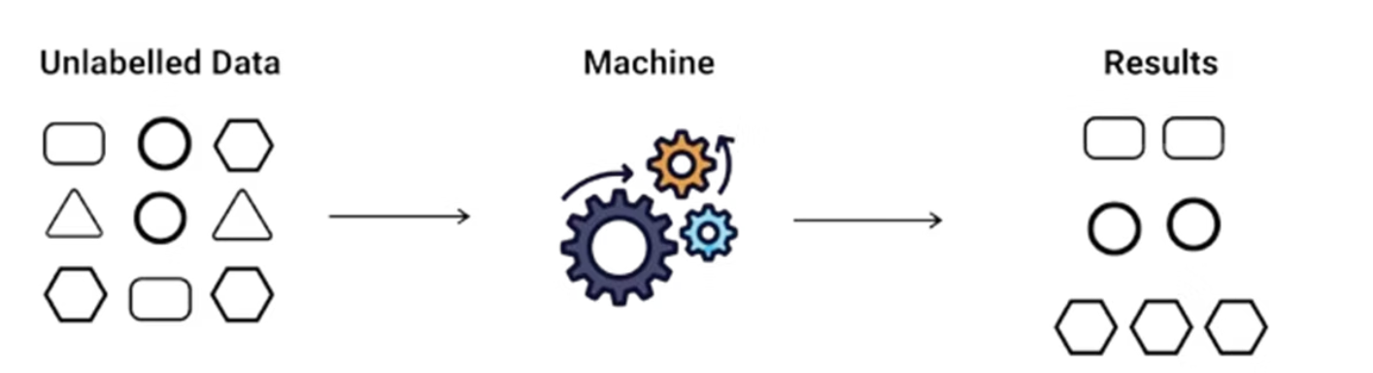



Unsupervised Learning: Uncovering Hidden Traffic Patterns:
Complementing our supervised approach, unsupervised learning plays a crucial role in understanding the intricate dynamics of 5G networks without relying on predefined labels. This branch of machine learning is designed to discover hidden structures, patterns, and groupings within unlabeled network data.
•No Labels: The dataset contains only input features, with no predefined outputs.
•Goal: To discover hidden patterns, groupings, or anomalies in the data.
•Identifies patterns and relationships in data without requiring labels
Fig. 6 – Unsupervised Learning
No Labels Needed
Traffic Grouping
Pattern Detection
Discovers patterns in data without prior knowledge of output categories, ideal for exploring new network behaviours.
Identifies natural clusters of similar traffic flows, enabling categorisation of applications or user types.
Reveals hidden structures and anomalies that might indicate emerging trends or potential security threats.

Slide 15



K-Means Clustering: Identifying Core Traffic Groups:
K-Means clustering is a fundamental unsupervised learning algorithm that partitions network traffic data into K distinct clusters. Each data point is assigned to the cluster whose centroid it is closest to, effectively grouping similar traffic behaviours.
Traffic Grouping
Simple Patterns
Easy example:If you give K=3, it tries to divide your traffic into:
Organises data into predefined 'K' clusters based on feature similarity.
Effective for identifying clear, spherical, and well-separated traffic patterns.
Cluster 1 → low load
Cluster 2 → medium load
Cluster 3 → high load
Strength: Very fast and simple.

Slide 16
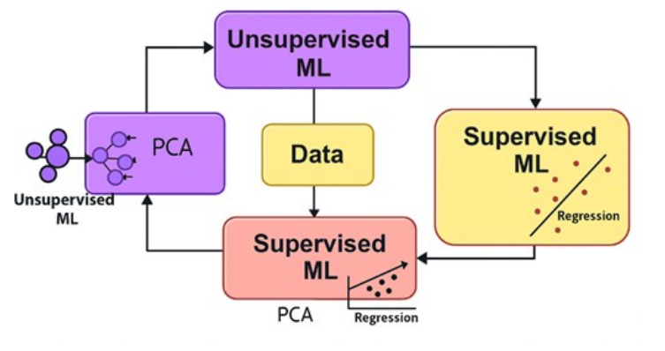
PCA: Dimensionality Reduction for Enhanced Insights
Principal Component Analysis (PCA) is a crucial preprocessing step, transforming high-dimensional data into a lower-dimensional space while retaining most of its variance. This enables easier visualisation and more efficient clustering of complex 5G traffic patterns.
Data Simplification
Cluster Visualisation
Reduces the number of features in the dataset, combating the curse of dimensionality.
Enables plotting and interpreting cluster results in 2D or 3D space, revealing hidden patterns.
Fig. 7 - Block diagram illustrates the working of PCA in an Unsupervised model and is parallel performing Regression in supervised model .

Slide 17
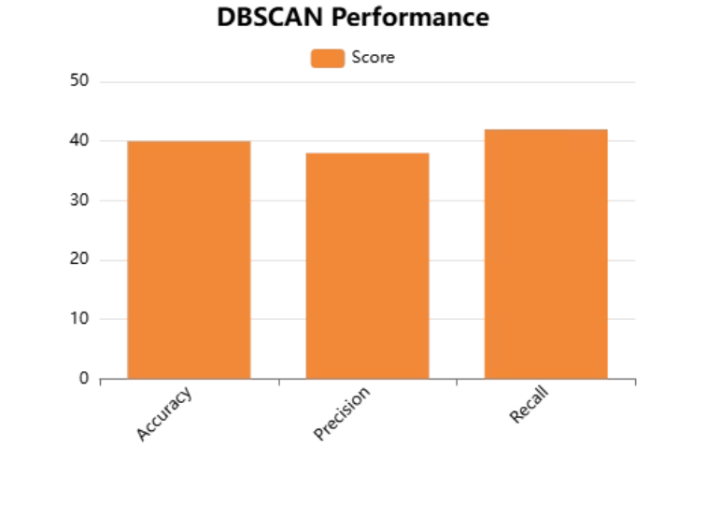

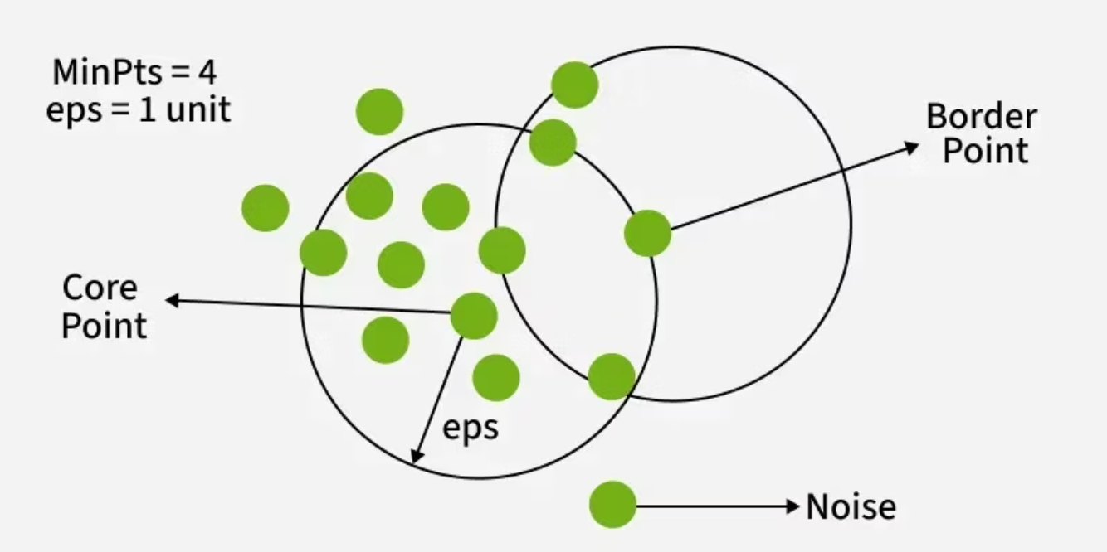
1. DBSCAN:
DBSCAN (Density-Based Spatial Clustering of Applications with Noise) is a powerful algorithm for discovering clusters of arbitrary shapes in spatial data. Its key advantage in 5G networks is its ability to identify dense traffic regions and outlier anomalies.
Density-Based Detection
Anomaly Detection
Identifies clusters based on the density of data points, not predefined shapes.
Excellent for flagging unusual traffic spikes or behaviours as noise points.
Fig. 8 – DBSCAN Accuracy
Improved Accuracy
Achieves approximately 40% accuracy in detecting complex traffic patterns.
Fig. 9 – DBSCAN

Slide 18
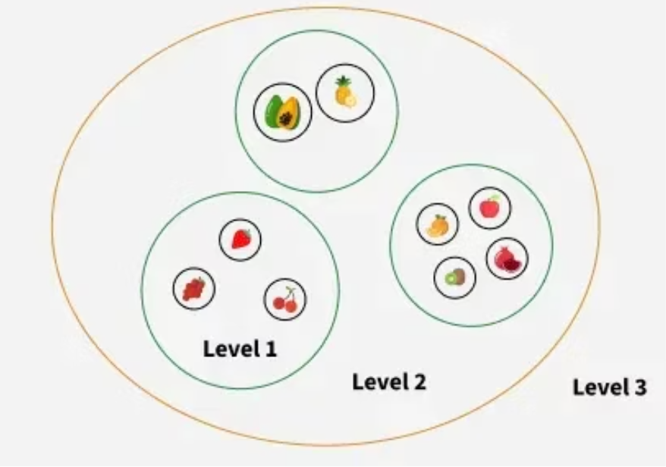
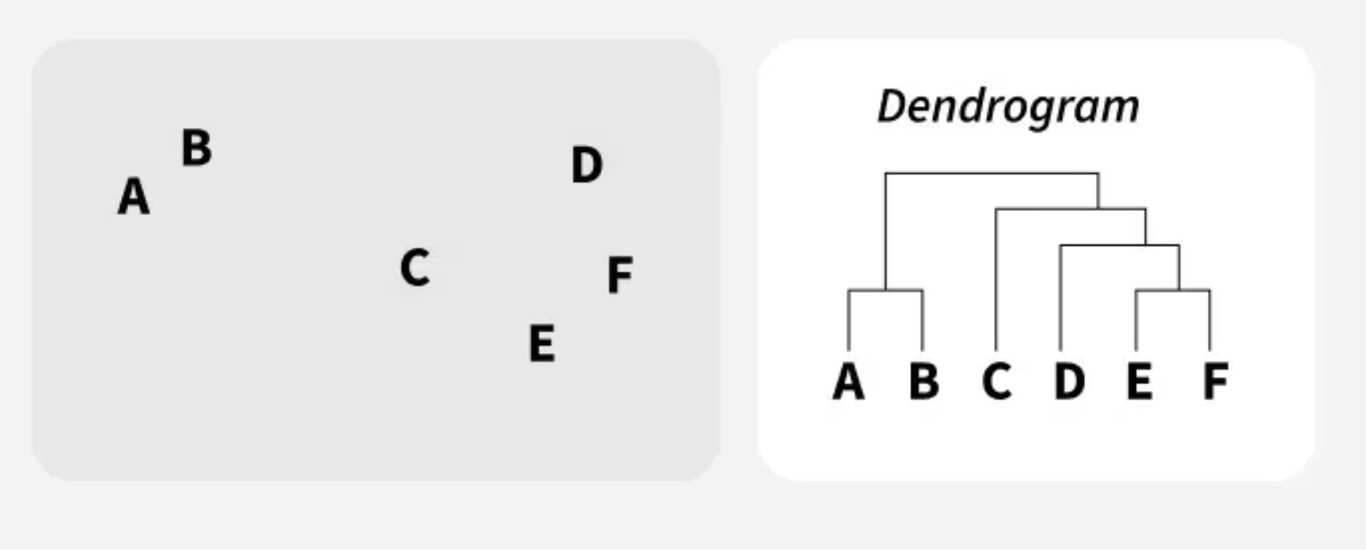
2. Hierarchical Clustering:
Hierarchical clustering builds a tree-like structure, known as a dendrogram, illustrating the nested relationships between traffic data points. This method provides a clear, step-by-step visualisation of how clusters are formed.
Dendrogram Construction
Visualises cluster formation, allowing for dynamic cluster count selection.
Step-by-Step Clarity
Shows the merging or splitting of clusters at each iteration, providing detailed insight.
Fig.10 - Hierarchical clustering
Lower Accuracy
Demonstrated very low accuracy (~19%) for dynamic 5G traffic analysis.
Fig. Dendrogram Construction

Slide 19

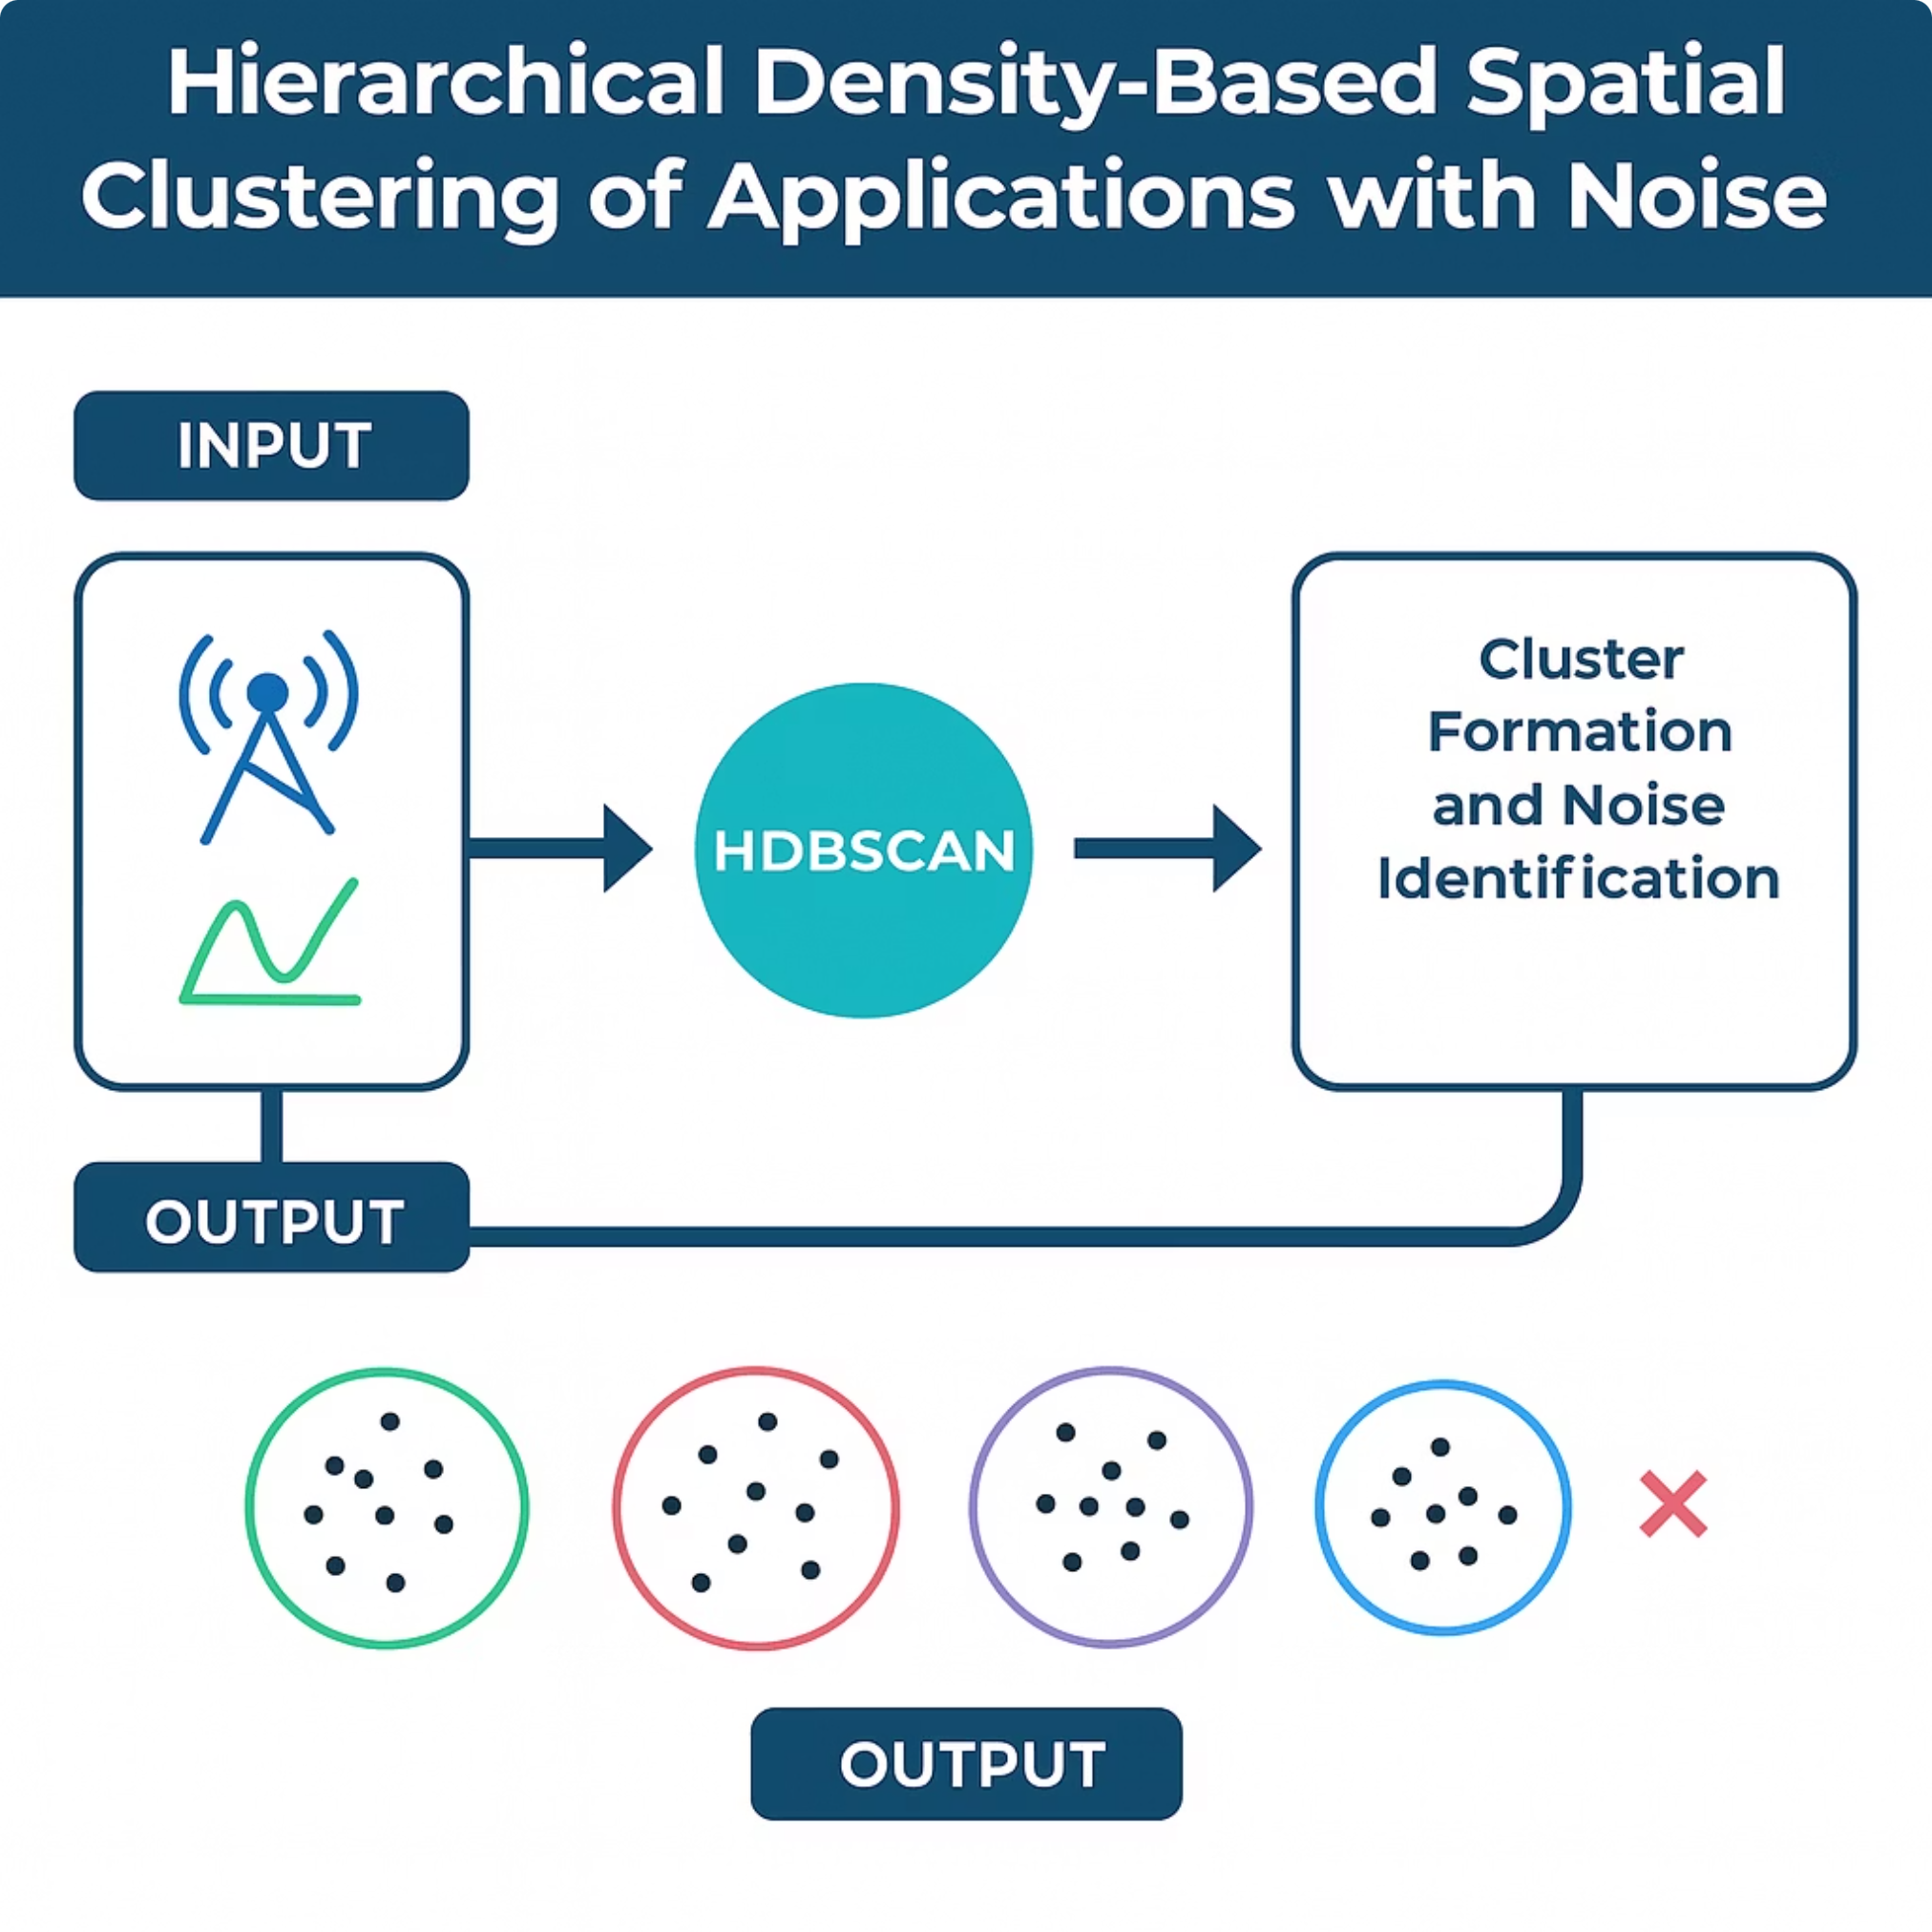
3. HDBSCAN:
HDBSCAN (Hierarchical Density-Based Spatial Clustering of Applications with Noise) is an advanced clustering algorithm that extends DBSCAN, capable of identifying clusters of varying densities. This makes it exceptionally well-suited for the complex and irregular behaviour of real 5G traffic.
Varying Density
Robust for 5G
Effectively clusters data with different densities, crucial for dynamic 5G scenarios.
Designed to handle the nuances and unpredictable nature of modern network traffic.
Highest Accuracy
Achieved the highest accuracy in our evaluations, approximately 71% for 5G traffic.
Fig. 11 – HDBSCAN Cluster

Slide 20
LITERATURE SURVEY
SL.NO | TITLE | PURPOSE | MERITS | DEMERITS
1 | 5G ConGest: A Hybrid ML Model for Smart Congestion Prediction | Adaptive 5G congestion control using hybrid supervised and unsupervised learning. | Real-time, scalable, proactive, reduced latency, network optimization, adaptive. | Complexity,data dependency
2 | Adaptive Congestion Control in 5G Networks: Integrating Supervised and Unsupervised Machine Learning Techniques for Real-Time Traffic Managemen | Predict and control 5G congestion using hybrid ML. | Efficiency, scalability, adaptability, proactive control, real-time insights. | maintenance-heavy, training delays
3 | Study and investigation on 5G technology: A systematic review | Systematic review of 5G technology advancements, challenges, and applications. | Comprehensive, informative, objective | Lack of novelty, potentially outdated, complex understanding.
4 | Technologies for 5G networks: Challenges and opportunities | Explore 5G technologies, challenges, and opportunities for future growth. | Industry-relevant, comprehensive, identifies challenges, highlights growth potential. | outdated quickly,limited scope, uncertain impact.

Slide 21
SL.NO | TITLE | PURPOSE | MERITS | DEMERITS
5 | A comprehensive overview of TCP congestion control in 5G networks | Evaluate TCP congestion control mechanisms in 5G's high-density, mmWave environments . | Comprehensive analysis of algorithms, identifies future 5G challenges and solutions . | Limited practical validation in ML approaches .
6 | ‘Congestion control techniques in 5G mm wave networks | Efficient congestion management in 5G mmWave networks using advanced techniques. | High-speed, low-latency, adaptive, scalable, optimized traffic flow, enhanced reliability. | High infrastructure cost, signal blockages, weather sensitivity, complex implementation
7 | An artificial intelligence framework for deployment in 5G networks | Develop an AI-driven framework for efficient deployment in 5G networks. | Intelligent automation, scalability, real-time optimization, improved efficiency, adaptive control | High computational cost, complexity, data integration challenges
8 | An effective model for network selection and resource allocation in 5G | Develop an optimized model for network selection and resource allocation in 5G. | Efficient resource utilization, low latency, adaptive, scalable, improved connectivity. | High complexity

Slide 22
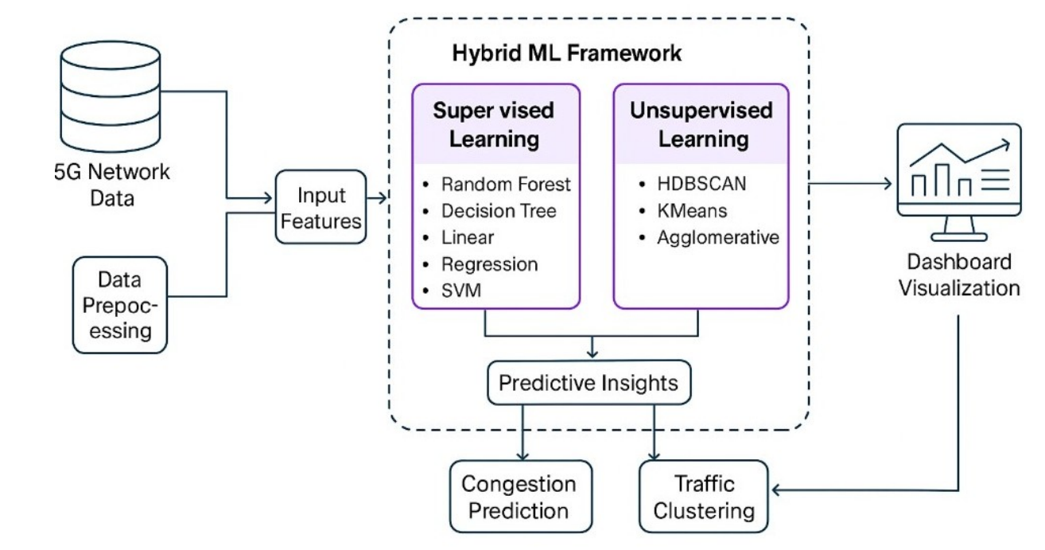
METHODOLOGY
The Hybrid Machine Learning Model using a Parallel Hybrid Approach, where Supervised ML and Unsupervised ML run independently but on the same dataset, and their outputs are combined for final analysis.
Data Preparation & Feature Extraction
Parallel Model Execution
Supervised Learning for Prediction
Unsupervised Learning for Pattern Discovery
Independent Output Generation
Output Integration Layer
Visualization in Web Dashboard
Fig. 13 - The complete working of a Hybrid framework it starts with data preprocessing to visualization of the results.

Slide 23
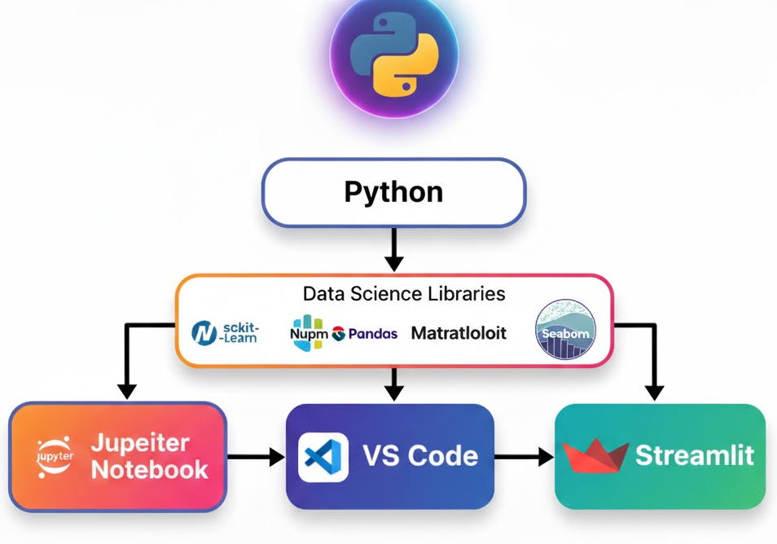
TOOLS AND TECHONOLOGY
Programming & Development
•Python – Core language for building ML models
•Streamlit – For creating the interactive web dashboard
•Jupyter Notebook / VS Code – For development, testing, and visualization
2. Machine Learning Frameworks
•Scikit-Learn – Used for supervised models (Linear Regression, Decision Tree, Random Forest, SVM)
•Scikit-Learn & HDBSCAN Library – Used for clustering (KMeans, DBSCAN, HDBSCAN, Hierarchical)
•NumPy & Pandas – For data preprocessing and analysis
3. Visualization Tools
•Matplotlib & Seaborn – Used to plot graphs (line charts, scatter plots, PCA plots)
•Streamlit Charts – For real-time dashboard visualizations
4. Data Handling & Storage
•CSV Datasets – Used as input 5G network traffic data
•Pandas DataFrames – For structured data manipulation
5. Supporting Technologies
•PCA (Principal Component Analysis) – For dimensionality reduction
Fig. 14 – Flowchart

Slide 24
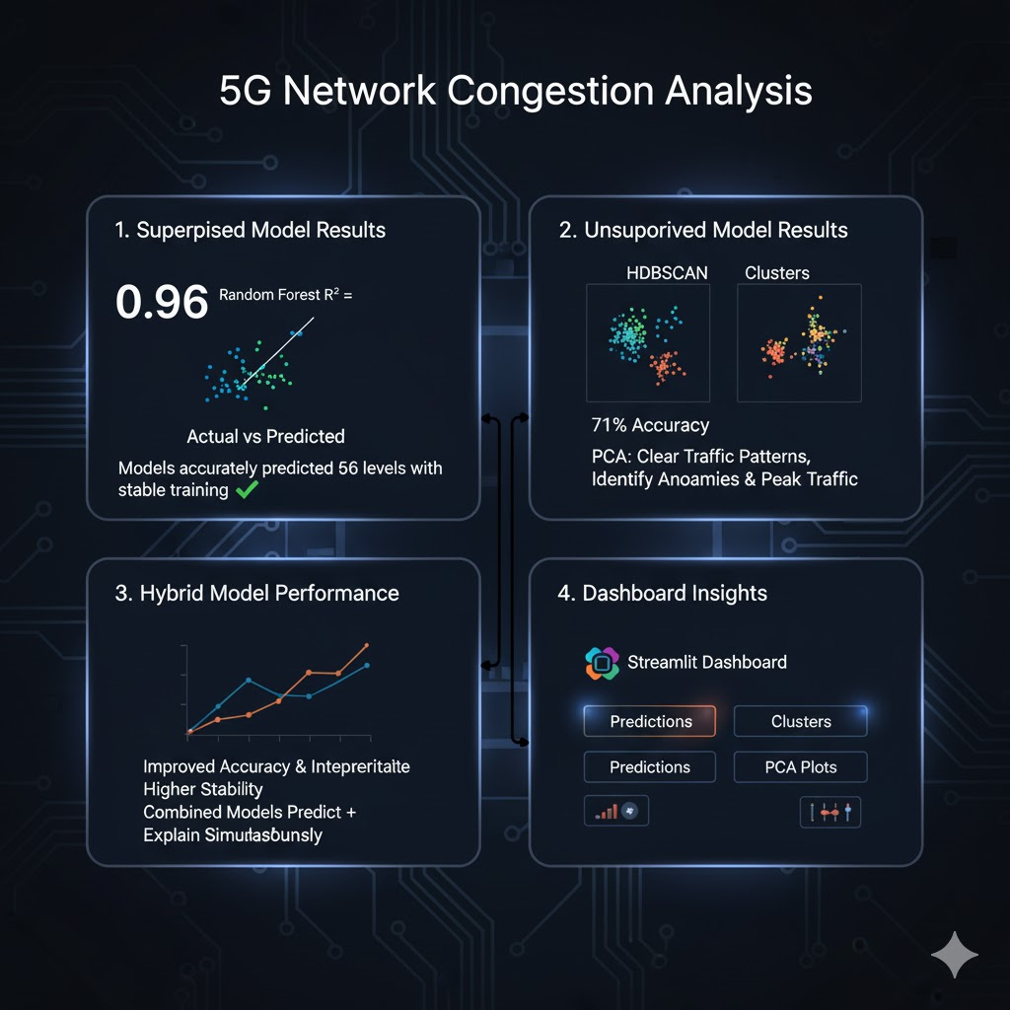
RESULTS & ANALYSIS
Supervised Model Results
Random Forest achieved the best performance with R² = 0.96.
Models accurately predicted 5G congestion levels with stable training.
Actual vs Predicted scatter plots showed strong alignment.
Unsupervised Model Results
HDBSCAN produced the most meaningful clusters (≈71% accuracy).
PCA visualizations showed clear separation of traffic patterns.
Clustering helped identify anomalies and peak-traffic behaviors.
Hybrid Model Performance
Combining both models improved accuracy and interpretability.
Hybrid approach predicted congestion and explained traffic behavior simultaneously.
Results showed higher stability compared to individual models.
Dashboard Insights
Streamlit dashboard visualized predictions, clusters, and PCA plots.
Graphs clearly showed model performance trends and cluster grouping.

Slide 25
CONCLUSION
The hybrid ML based congestion control prediction model for 5G environments effectively combines the strengths of both supervised and unsupervised learning techniques. It achieves high accuracy in predictive behavior and behavioral analysis through Random Forest as the supervising model and uses HDBSCAN for clustering.The consolidative addition of Principal Component Analysis helps in reducing dimensionality and achieving better visual understanding and interpretation for clustering. By utilizing the Streamlit interface, users can able for interactively pick models, feed in test data, and view results transparently and user friendly. The model performs strong outcomes, such as having an R² value of 0.96 using Random Forest and clustering accuracy of ~71% using HDBSCAN.This demonstrates the efficiency and applicability of the hybrid approach in handling traffic patterns within 5G networks environment.

Slide 26
FUTURE SCOPE
The lightweight mobile app can be created to enable users to view 5G congestion forecasts on the go. It would identical the key characteristics of the existing web dashboard in mobile friendly system. Since this calls for frontend development and app store publishing, its outside of current scope. This idea is perfect for future scalability and real-world use.
Automated Dataset ExpansionA future enhancement can include automated dataset collection from live network logs.This helps the model learn from new patterns without manual dataset updates.Currently the data is static, but auto-updating datasets would improve long-term accuracy.This is an add-on feature and does not require changing your current algorithm.

Slide 27
REFERENCES
[1] Kamel, M. B., Najm, I. A., & Hamoud, A. K. (2024). 5G ConGest: A Hybrid ML Model for Smart Congestion Prediction. IEEE Access.
[3] Dangi, R., Lalwani, P., Choudhary, G., You, I., & Pau, G. (2021). Study and investigation on 5G technology: A systematic review. Sensors, 22(1), 26.
[4] Al-Falahy, N., & Alani, O. Y. (2017). Technologies for 5G networks: Challenges and opportunities. It Professional, 19(1), 12-20.
[5] Lorincz, J., Klarin, Z., & Ožegović, J. (2021). A comprehensive overview of TCP congestion control in 5G networks: Research challenges and future perspectives. Sensors, 21(13), 4510.
[6] Hindawi, B., & Abbas, A. S. (2021, April). Congestion control techniques in 5G mm wave networks: A review. In 2021 1st Babylon International Conference on Information Technology and Science (BICITS) (pp. 305-310). IEEE.
[7] Dandachi, G., De Domenico, A., Hoang, D. T., & Niyato, D. (2019). An artificial intelligence framework for slice deployment and orchestration in 5G networks. IEEE Transactions on Cognitive Communications and Networking, 6(2), 858-871.
[8] Urooj, S., Arunachalam, R., Alawad, M. A., Tripathi, K. N., Sukumaran, D., & Ilango, P. (2024). An effective model for network selection and resource allocation in 5G heterogeneous network using hybrid heuristic-assisted multi-objective function. Expert Systems with Applications, 248, 123307.

Slide 28


